Slide 1
6G Upper Mid-band Technology and Spectrum
RIT
Shima Mashhadi
Jan 2025

Slide 2
RIT
Topics To Covers
6G Technology
6G usage and capabilities
6G spectrum
Upper Mid-band Outdoor Coverage
Upper Mid-band Services
Upper Mid-band Spectrum Sharing

Slide 3
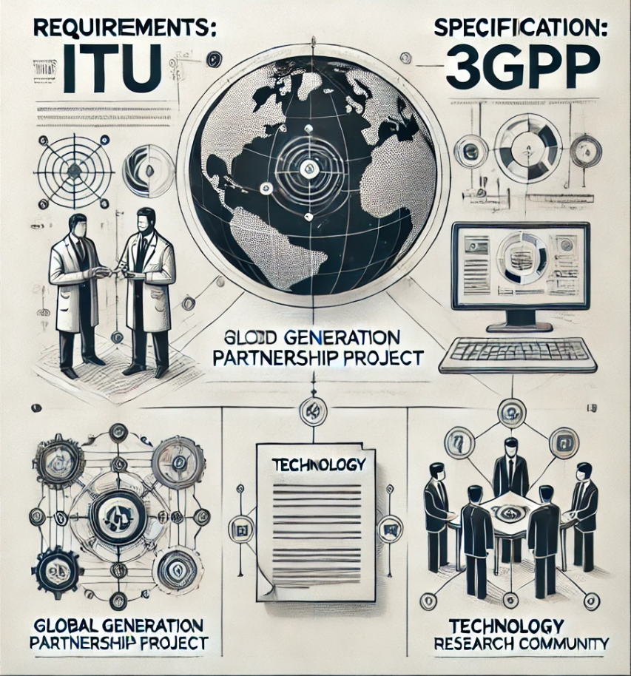

RIT
Key Players in 6G Development
Requirements: ITU
Specification: 3GPP (3rd Generation Partnership Project)
Technology component: Global research community
Generated by ChatGPT

Slide 4
RIT
The pathway to 6G Development
Requirements: ITU
Specification: 3GPP (3rd Generation Partnership Project)
Technology component: Global research community
2019-2023 | 2024 | 2025 | 2026 | 2027 | 2028 | 2029 | 2030 | 2031
Research into 'enabling technologies'
Deployment and service development
https://www.ericsson.com/49ac9c/assets/local/reports-papers/white-papers/2024/6g-spectrum.pdf
Why it’s a great time to start talking 6G - Ericsson
6G standardization timeline and principles – Ericsson
6G: What, why, and how? - YouTube

Slide 5
RIT
The pathway to 6G Development
Requirements: ITU
Specification: 3GPP (3rd Generation Partnership Project)
Technology component: Global research community
2019-2023 | 2024 | 2025 | 2026 | 2027 | 2028 | 2029 | 2030 | 2031
Research into 'enabling technologies'
IMT-2030 performance requirement
IMT-2030 Technical proposals
WRC-23
WRC-27
Deployment and service development
IMT = international Mobile Telecommunication
6G: What, why, and how? - YouTube

Slide 6

RIT
The pathway to 6G Development
Requirements: ITU
Specification: 3GPP (3rd Generation Partnership Project)
Technology component: Global research community
2019-2023 | 2024 | 2025 | 2026 | 2027 | 2028 | 2029 | 2030 | 2031
Research into 'enabling technologies'
IMT-2030 performance requirement
IMT-2030 Technical proposals
WRC-23
WRC-27
3PP Release 19
Rel. 20
Rel. 21
Study Items Work items technical specifications
6G
Deployment and service development
IMT = international Mobile Telecommunication
https://www.ericsson.com/49ac9c/assets/local/reports-papers/white-papers/2024/6g-spectrum.pdf
6G: What, why, and how? - YouTube

Slide 7
RIT
The pathway to 6G Development
Requirements: ITU
Specification: 3GPP (3rd Generation Partnership Project)
Technology component: Global research community
2019-2023 | 2024 | 2025 | 2026 | 2027 | 2028 | 2029 | 2030 | 2031
Research into 'enabling technologies'
IMT-2030 performance requirement
IMT-2030 Technical proposals
WRC-23
WRC-27
3PP Release 19
Rel. 20
Rel. 21
Rel. 22
Rel. 23
Study Items Work items technical specifications
6G
Enhancements
Deployment and service development
IMT = international Mobile Telecommunication
https://www.ericsson.com/49ac9c/assets/local/reports-papers/white-papers/2024/6g-spectrum.pdf
6G: What, why, and how? - YouTube

Slide 8
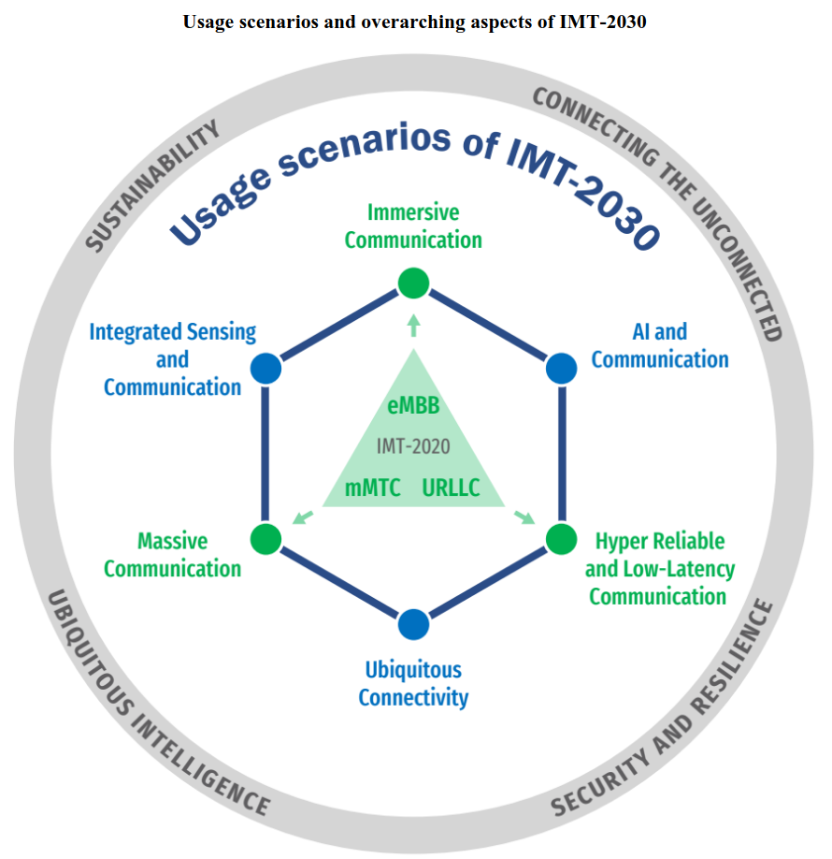
RIT
IMT-2030 Requirements: Usage scenarios
Immersive Communication
Hyper Reliable and Low-Latency Communication
Massive Communication
Integrated Sensing and Communication
Artificial Intelligence and Communication
Ubiquitous Connectivity
eMBB = Enhnce mobile broadband
mMTC = Massive machine-type communications
URLLC= Ultera-reliable low latency communication
https://www.itu.int/en/ITU-R/study-groups/rsg5/rwp5d/imt-2030/Documents/IMT-2030%20Capabilities%20post%20SG5.pdf
6G: What, why, and how? – YouTube
https://www.sharetechnote.com/html/6G/6G_WhatIsIt.html#ITU

Slide 9
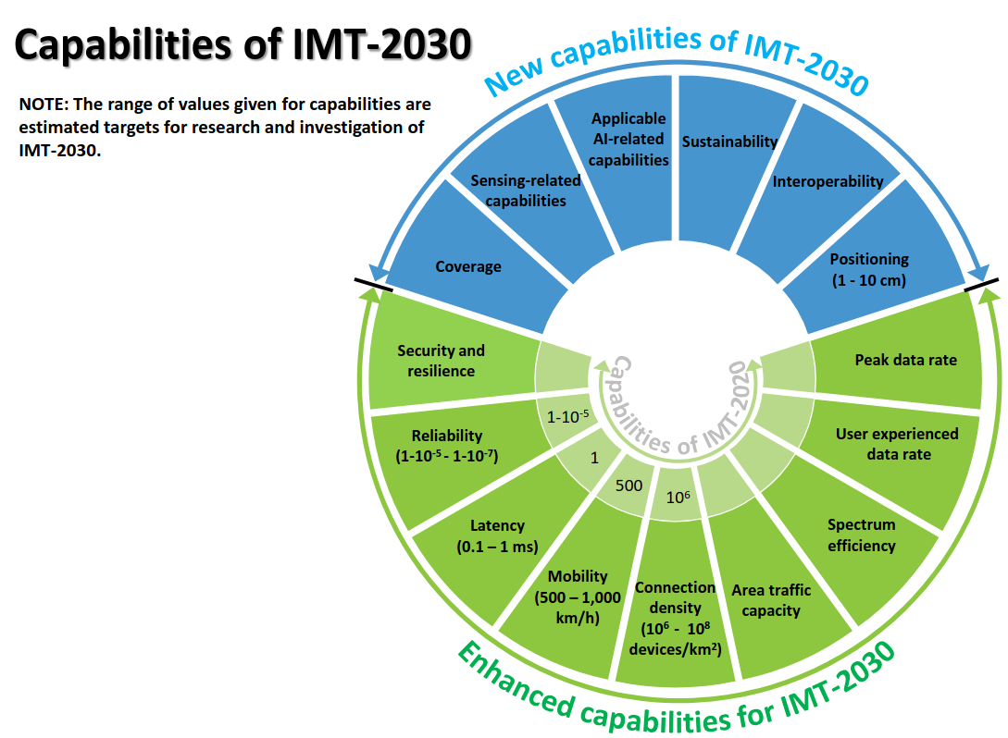
RIT
IMT-2030 Requirements: Capabilities
Peak data rate
50, 100, 200 Gbit/s are given as possible examples
User experienced data rate
300 Mbit/s and 500 Mbit/s are given as possible examples,
https://www.itu.int/en/ITU-R/study-groups/rsg5/rwp5d/imt-2030/Documents/IMT-2030%20Capabilities%20post%20SG5.pdf

Slide 10
RIT
6G Spectrum
2G-4G
5G
5G
600 MHZ
2 GHz
3.5 GHz
28 GHz
100 GHz
300 GHz
Low
Mid
Upper Mid
High
Band
FR1
FR3
FR2
FR = Frequency Range
410 – 7125 MHz
7.125 – 24.25 GHz
24.25 - 71.0 GHz
6G in the Upper Mid-Band: The Rise of Gigantic MIMO

Slide 11
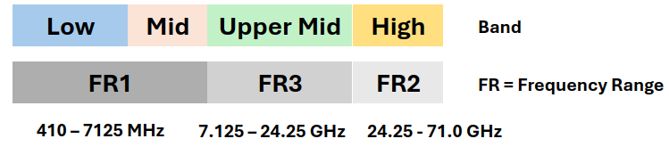
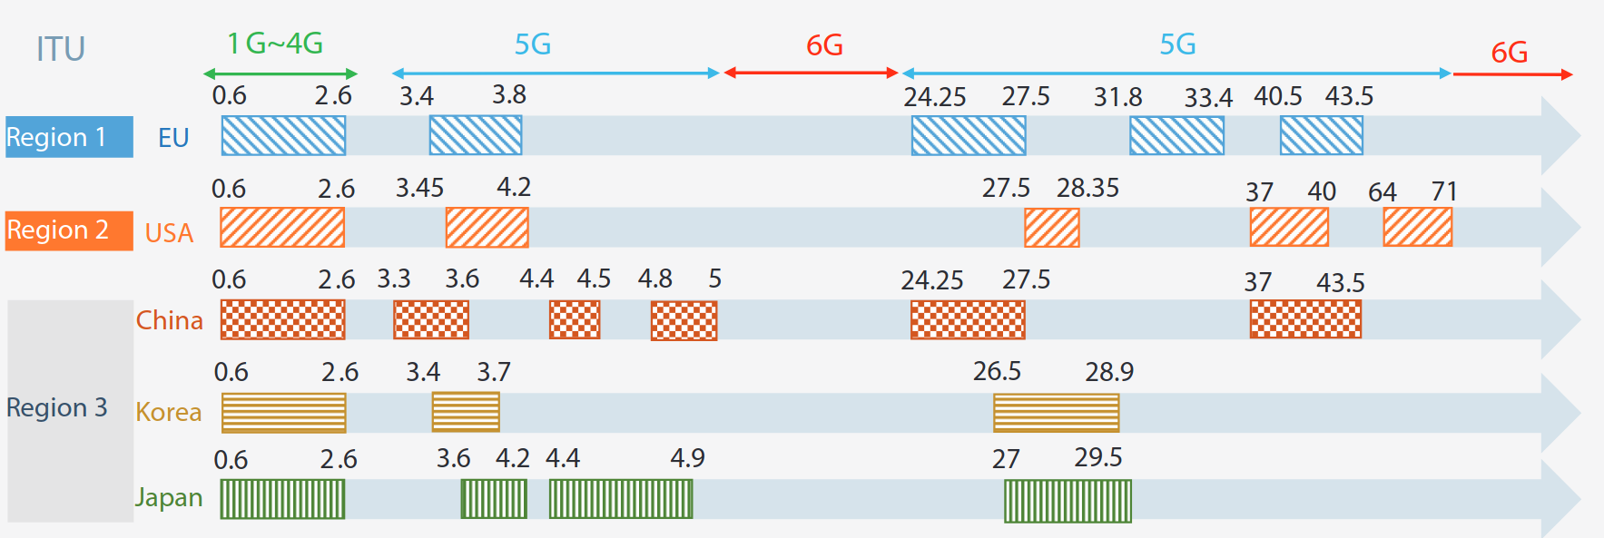
RIT
2G-5G Spectrum
2G-4G
5G
5G
600 MHZ
2 GHz
3.5 GHz
28 GHz
100 GHz
300 GHz
J. Zhang, H. Miao, P. Tang, L. Tian and G. Liu, "New Mid-Band for 6G: Several Considerations from the Channel Propagation Characteristics Perspective," in IEEE Communications Magazine, vol. 63, no. 1, pp. 175-180, January 2025, doi: 10.1109/MCOM.001.2300708.https://ieeexplore-ieee-org.ezproxy.rit.edu/stamp/stamp.jsp?tp=&arnumber=10559933

Slide 12
RIT
6G Spectrum
2G-4G
5G
5G
600 MHZ
2 GHz
3.5 GHz
28 GHz
100 GHz
300 GHz
Precision, More Bandwidth
Better Coverage
6G in the Upper Mid-Band: The Rise of Gigantic MIMO

Slide 13
RIT
6G Spectrum
mmWave for 6G?​
6G?
2G-4G
5G
5G
600 MHZ
2 GHz
3.5 GHz
28 GHz
100 GHz
300 GHz
6G in the Upper Mid-Band: The Rise of Gigantic MIMO

Slide 14
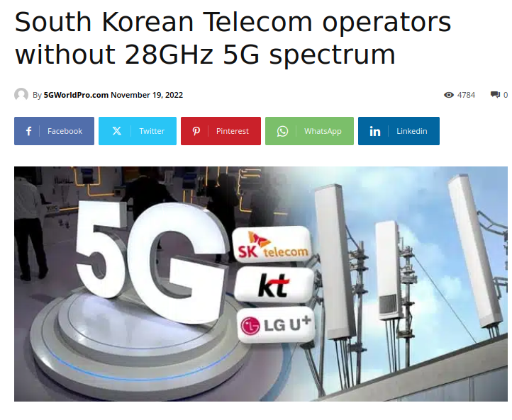
RIT
6G Spectrum
The South Korean government said on 18/11/2022 that it would cancel the spectrum allocated to local telcos for 5G network deployment, in light of the insufficient investment they have made in the area.
https://www.5gworldpro.com/blog/2022/11/19/south-korean-telecom-operators-without-28ghz-5g-spectrum/

Slide 15
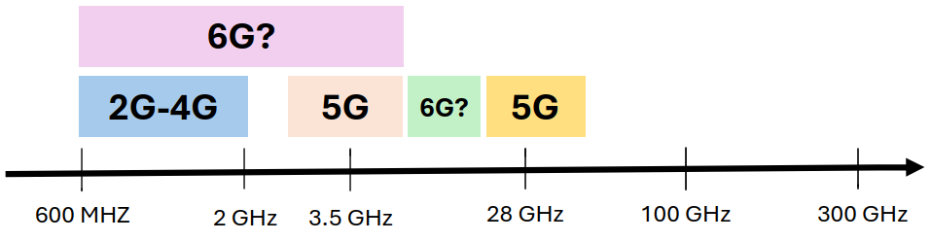
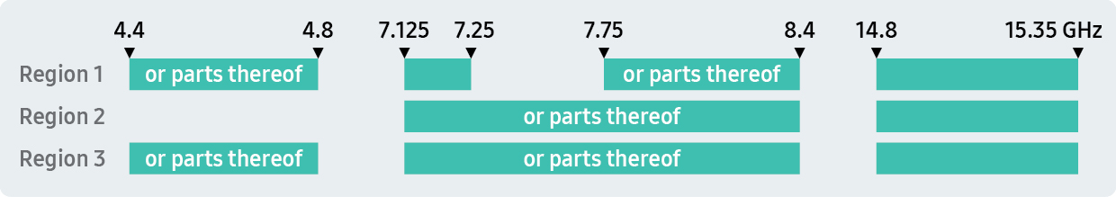
RIT
6G Spectrum in Upper Mid-Band
https://research.samsung.com/blog/Upper-Mid-Band-Spectrum-for-6G-Opportunities-and-Key-Enablers
Golden band
satisfy both capacity and coverage requirements

Slide 16
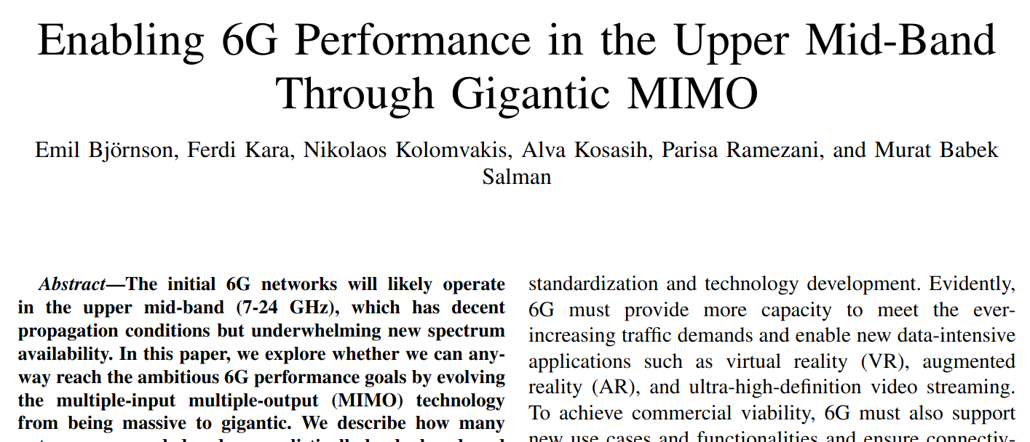
RIT

Slide 17
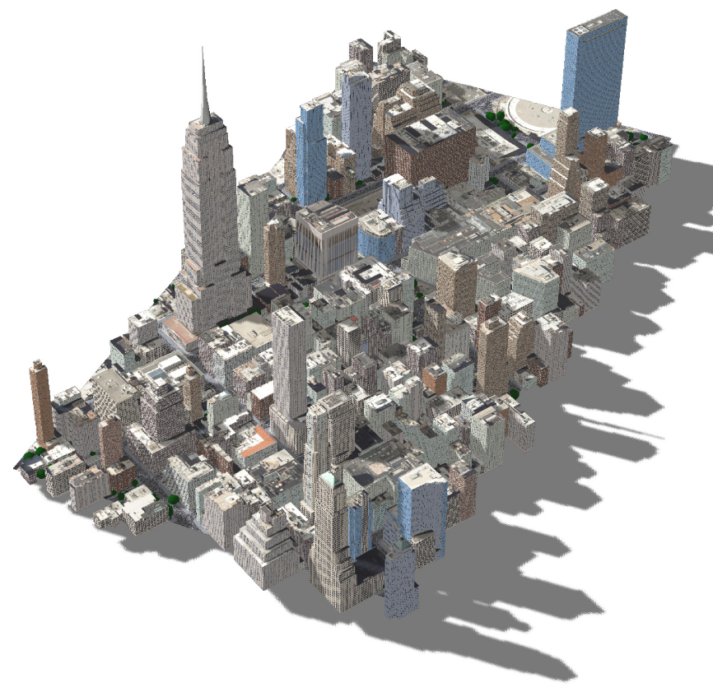
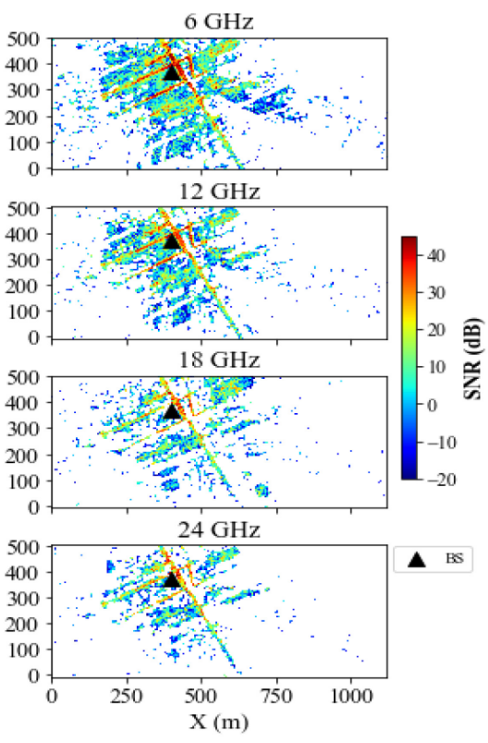
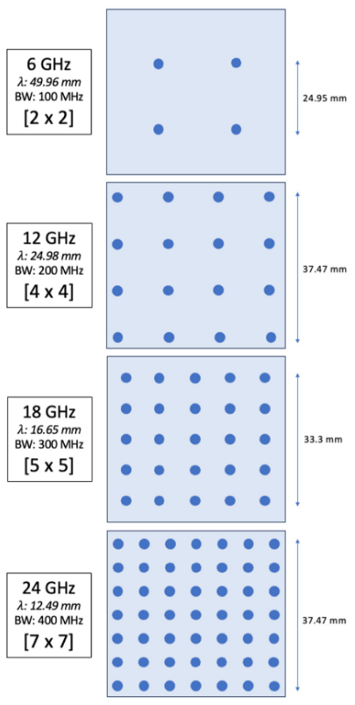
RIT
Upper Mid-band Outdoor Coverage
Ray tracing simulation for Herald Square in New York City
Kang S, Mezzavilla M, Rangan S, Madanayake A, Venkatakrishnan SB, Hellbourg G, Ghosh M, Rahmani H, Dhananjay A. Cellular wireless networks in the upper mid-band. IEEE Open Journal of the Communications Society. 2024 Mar 5.
https://www.free6gtraining.com/2024/12/6g-midband-spectrum-discussions-from.html?m=1

Slide 18
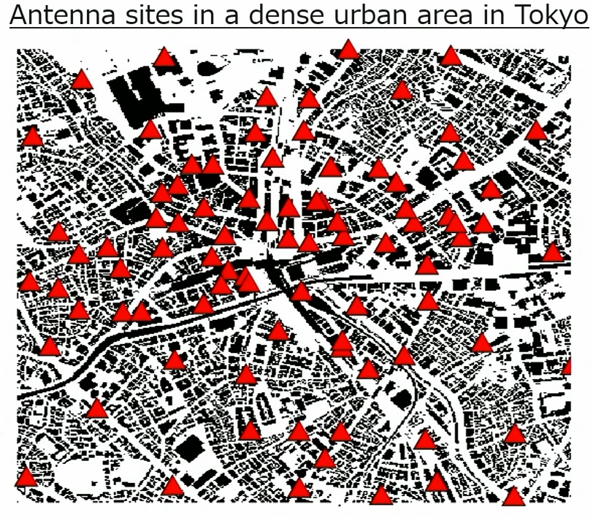

RIT
Upper Mid-band Outdoor Coverage
 | FR1 | FR3
Center frequency | 3.7 GHz | 7.4 GHz
Bandwidth | 100 MHz
# od Antenna elements | 32 (Digital BF) | 128 (Hybrid BF)
# of TRx | 32
Transmission power | 23 dBm per TRx
# of gNBs | 200
UE antenna gain | 0 dBi
Simulation area | 2km x 2km
# of considered rays | 4 Reflections- 1 Diffractions
https://www.free6gtraining.com/2024/12/6g-midband-spectrum-discussions-from.html?m=1
KDDI Research

Slide 19
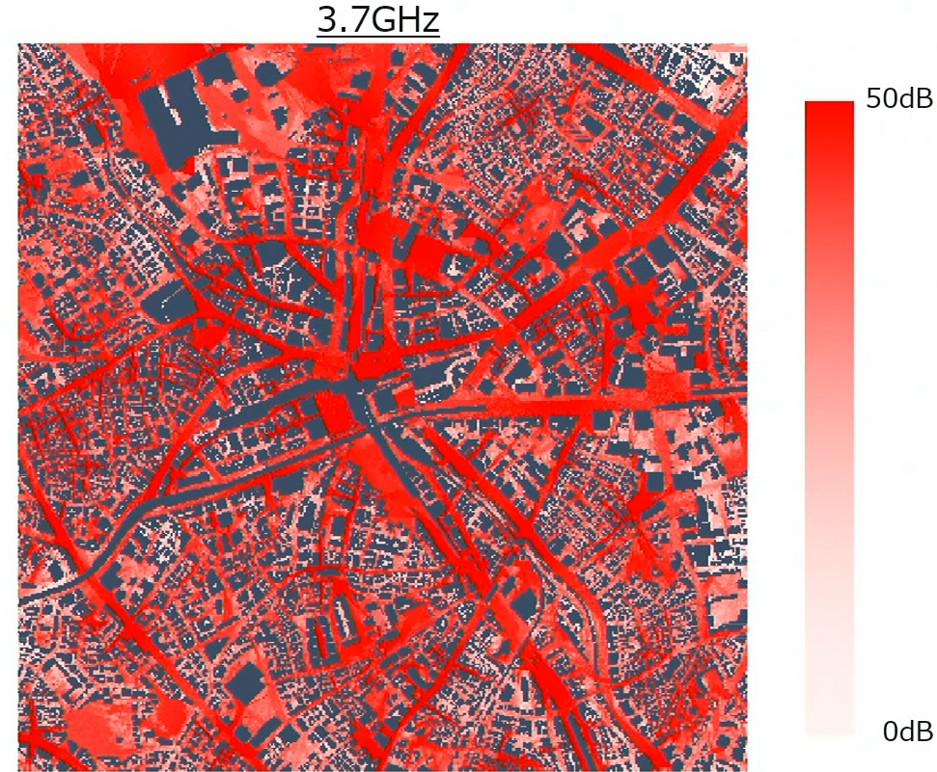
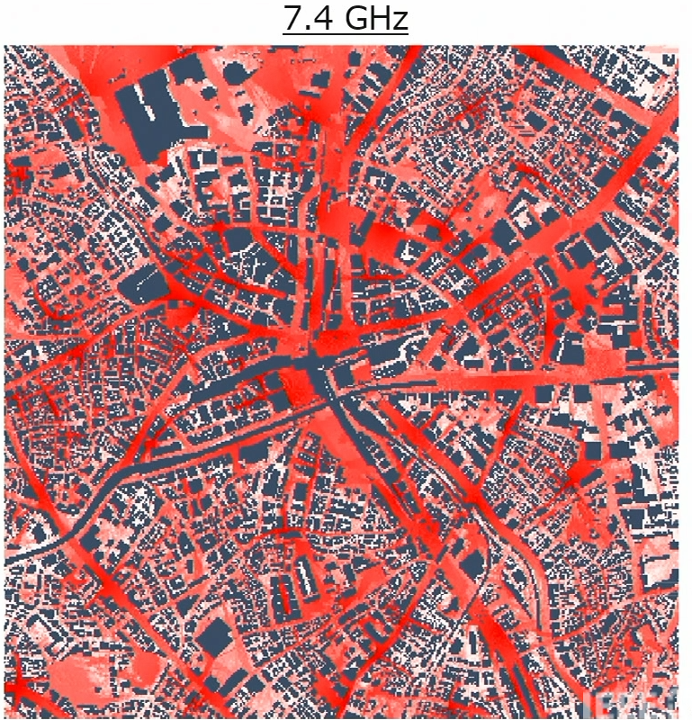
RIT
Upper Mid-band Outdoor Coverage

Slide 20
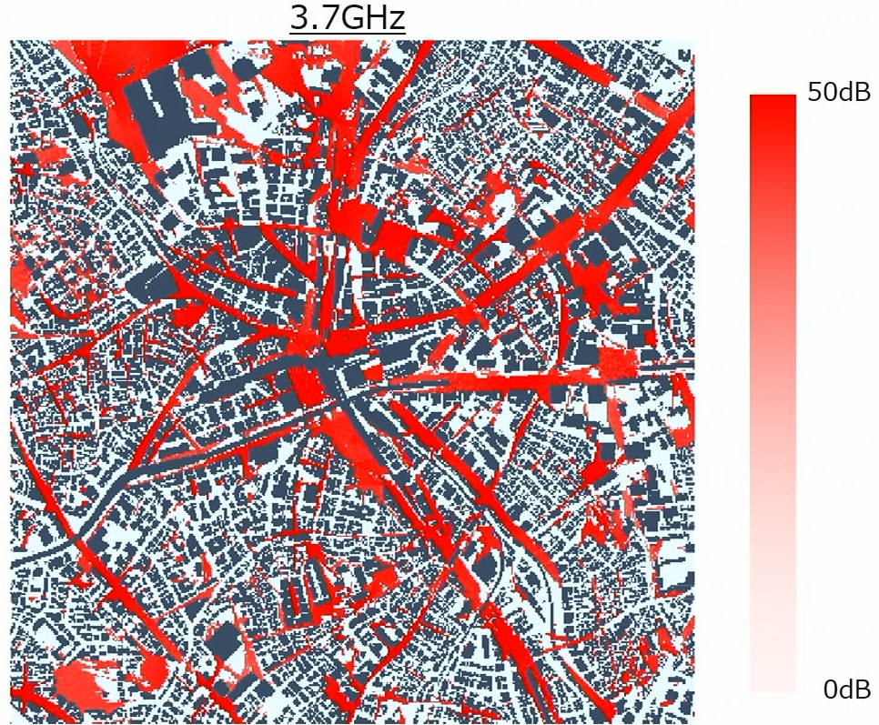
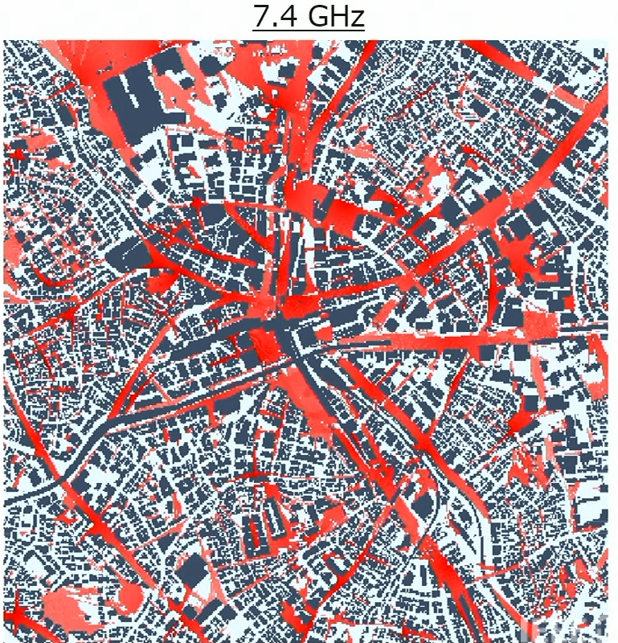
RIT
Upper Mid-band Outdoor Coverage

Slide 21
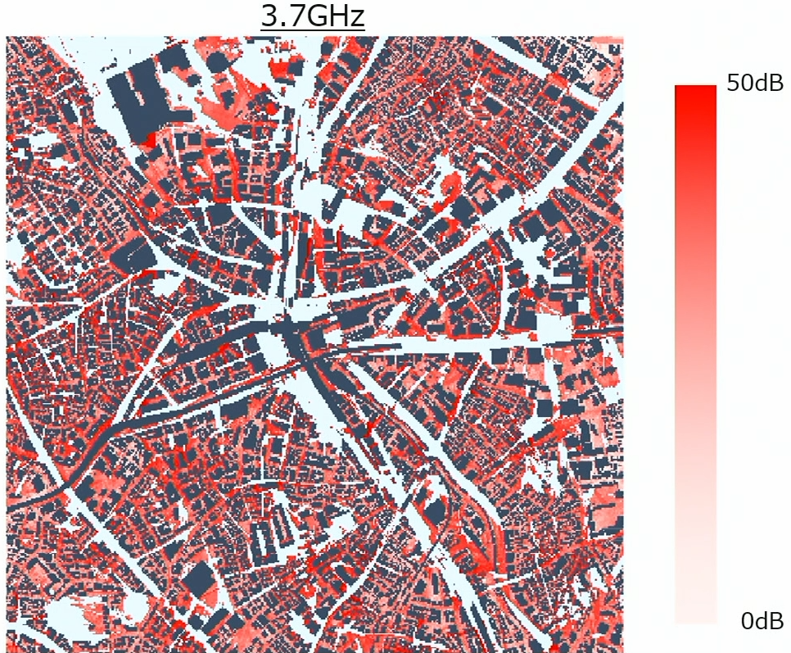
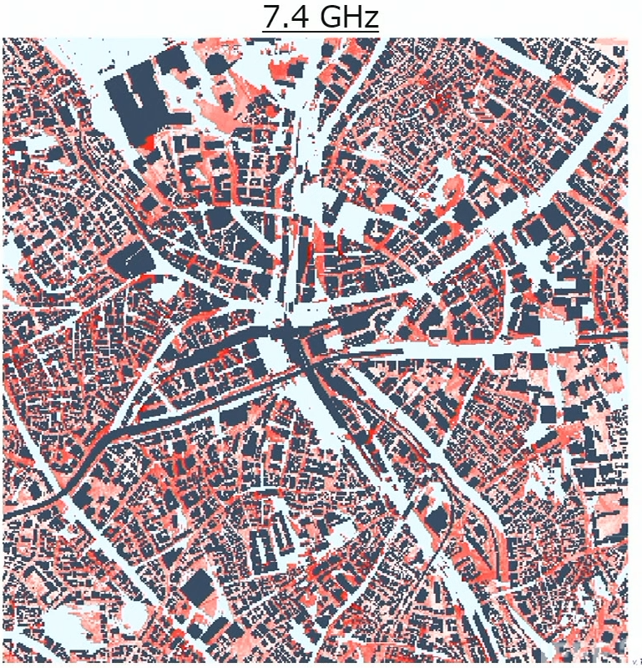
RIT
Upper Mid-band Outdoor Coverage

Slide 22
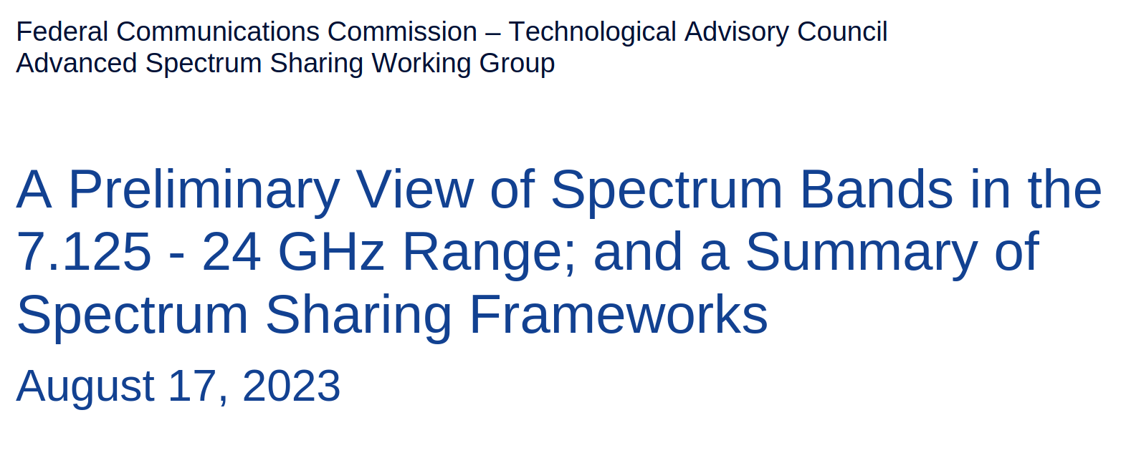
RIT
Upper Mid-band Spectrum Sharing

Slide 23
RIT
Need for spectrum sharing
"There is no more spectrum available." by Herbert Hoover, the US Secretary of Commerce, in 1925.
"Given that no desirable spectrum band is currently free of incumbents, the need for spectrum sharing is obvious." FCC report in 2023.

Slide 24
RIT
Need for Spectrum Sharing
"There is no more spectrum available." by Herbert Hoover, the US Secretary of Commerce, in 1925.
"Given that no desirable spectrum band is currently free of incumbents, the need for spectrum sharing is obvious." FCC report in 2023.
6G demand : Peak data rate 200 Gbit/s
Channel capacity (bit/s per access point)
More Bandwidth?
Bigger MIMO

Slide 25
RIT
Upper Mid-Band Services
Scientific Services in FR-3
Non-Scientific Services in FR-3
Earth Exploration Satellites (EESS)​
Inter Satellite (ISS)​
Meteorological Satellite Service (MetSat)​
Space Research (SRS)​
Radio Astronomy (RAS)​
Fixed​
Mobile ​
Fixed Satellite (FSS)​
Maritime Mobile Satellite (MMSS)​
Radiolocation (RLS)​
Aeronautical Radionavigation (AR)​
Mobile Satellite (MSS)​

Slide 26
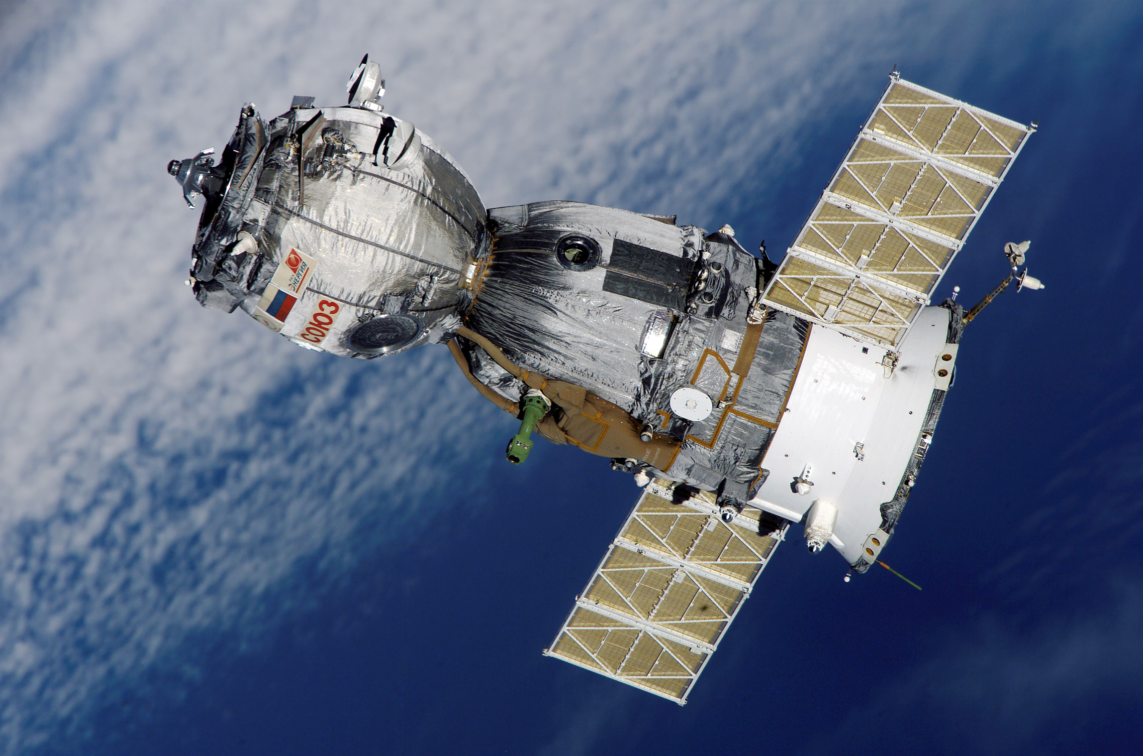
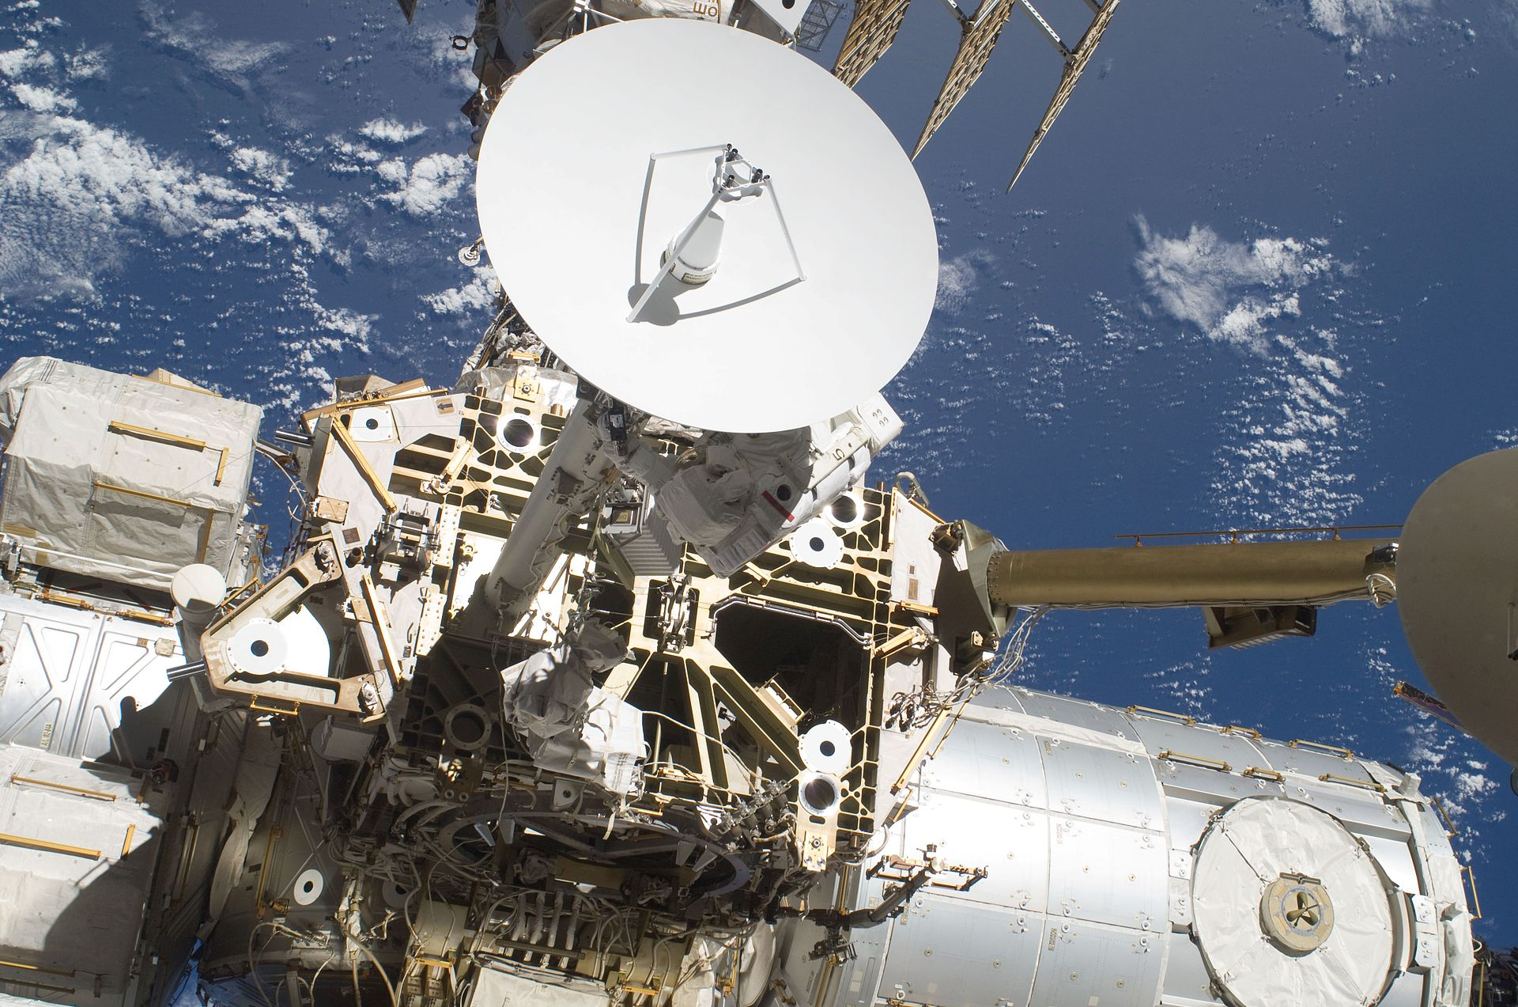
RIT
Scientific Services: Space Research (SRS)
​A radiocommunication service in which spacecraft or other objects in space are used for scientific or technological research purposes.
NASA's Deep Space Network
Communications with Mars rovers or telescopes like the James Webb or Hubble Space
https://en.wikipedia.org/wiki/Spacecraft
https://en.wikipedia.org/wiki/Space_research_service
https://en.wikipedia.org/wiki/Space_research_service

Slide 27
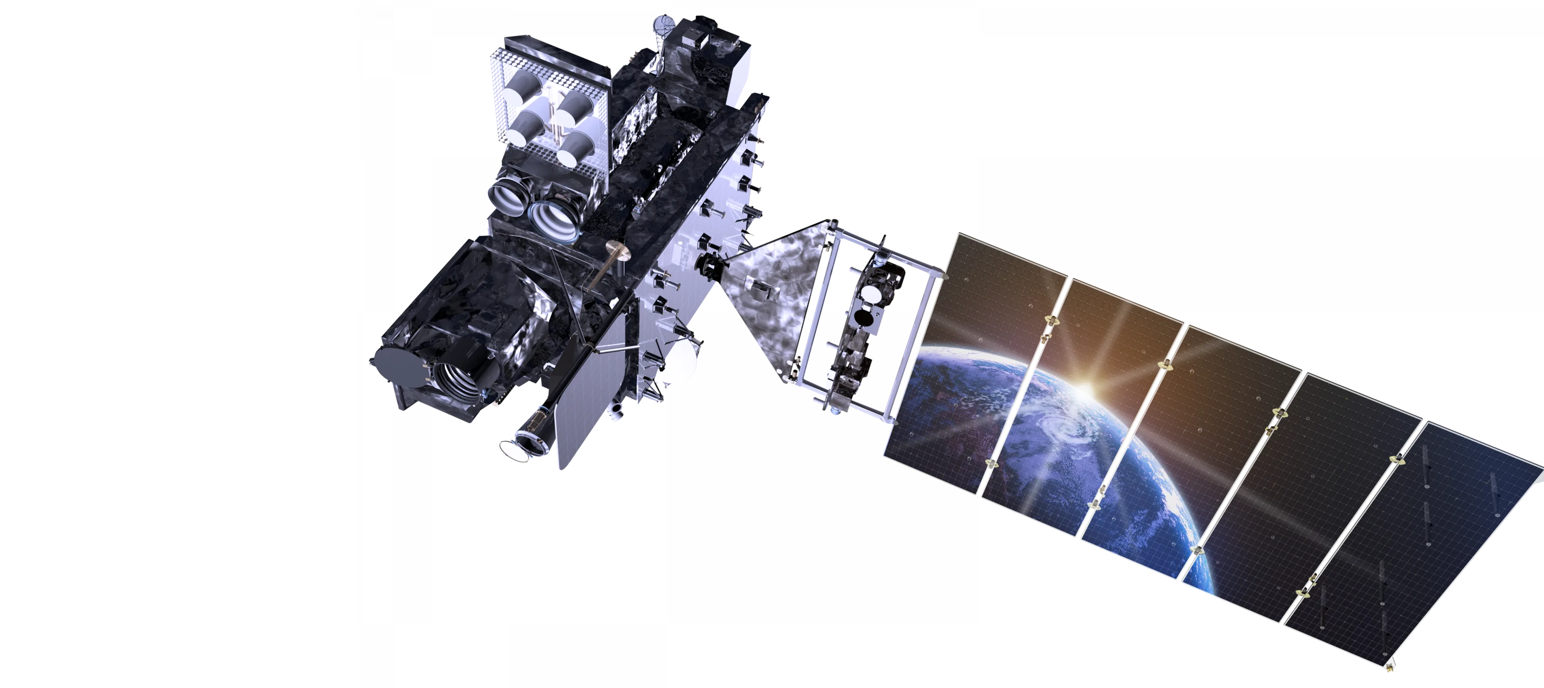
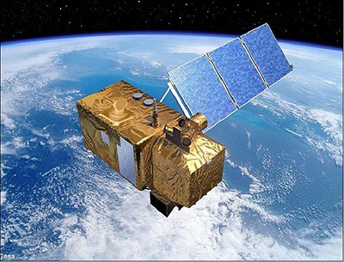
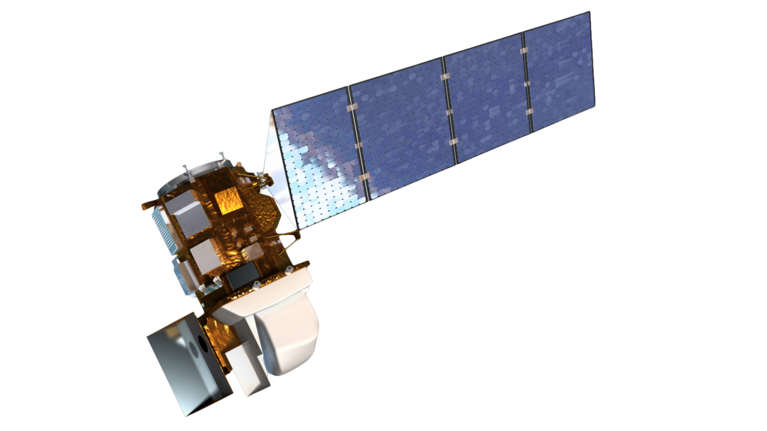
RIT
Scientific Services : Earth Exploration Satellites (EESS)
Using satellites to collect environmental data about the Earth's surface, atmosphere, and oceans.
Remote sensing
Weather satellites
weather forecasting, climate monitoring, natural disaster prediction,

Slide 28
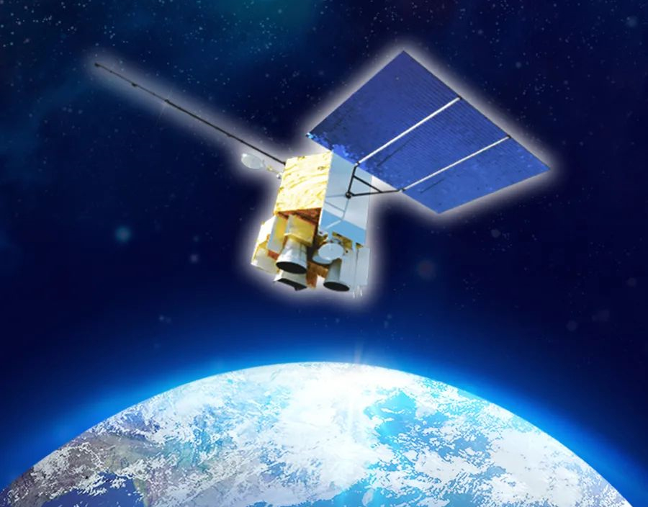
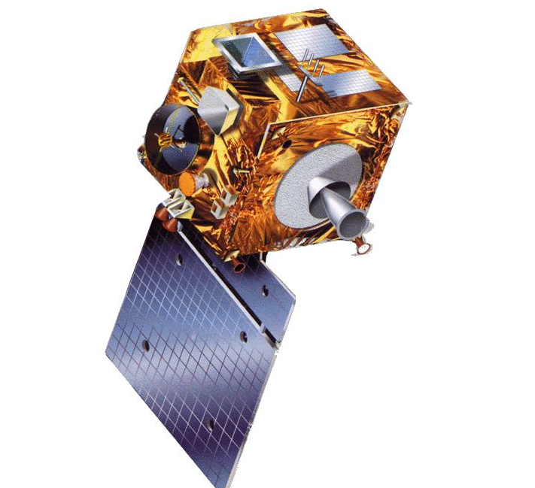
RIT
Scientific Services: Meteorological Satellite Service (MetSat)
An Earth exploration-satellite service for meteorological purposes. Satellites use sensors to collect data on weather conditions, including temperature, humidity, cloud cover, and wind patterns. These satellites send the collected information back to Earth.
Weather forecasting using satellites:​
GOES (USA)​
Himawari (Japan)​
Sentinel (Europe)
Notes:
Meteorological Satellite Service (MetSat) refers to satellites specifically designed to monitor and predict weather, study the atmosphere, and track environmental changes on Earth. The polar-orbiting satellites are also equipped with active and
passive microwave sensing instruments that provide for example vertical profiles of temperature and humidity on a worldwide basi
The huge amount of parameters and data from sensors on MetSat satellites
resulted in significant improvements in Numerical Weather Prediction (NWP).
Temprature – Pressure -

Slide 29
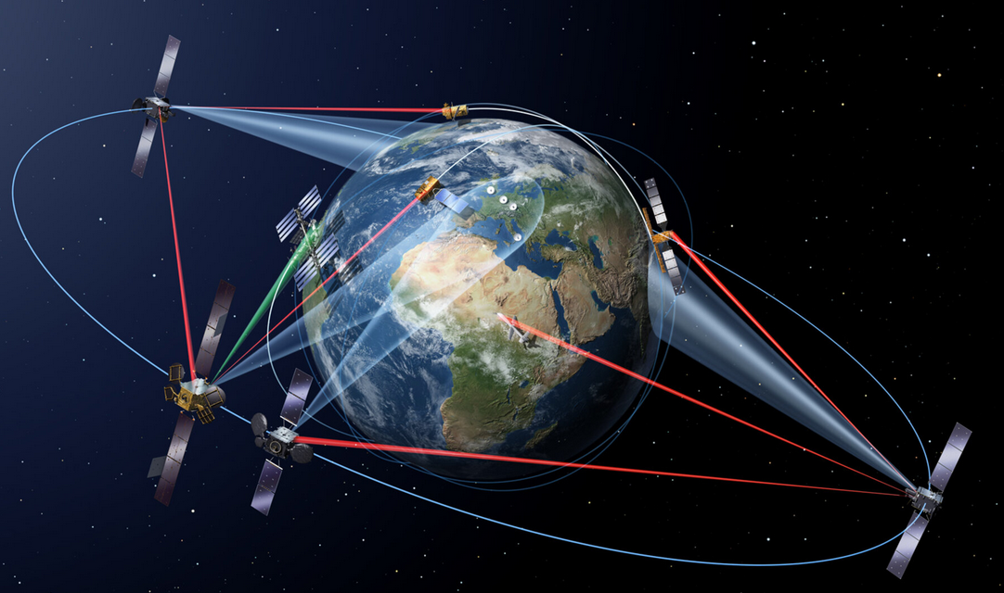
RIT
Scientific Services: Inter Satellite (ISS)
A radiocommunication service in which spacecraft or other objects in space are used for scientific or technological research purposes.
Communication within satellite constellations, such as Starlink.​
https://www.esa.int/ESA_Multimedia/Images/2016/02/Inter-satellite_laser_links
https://en.wikipedia.org/wiki/Inter-satellite_service

Slide 30
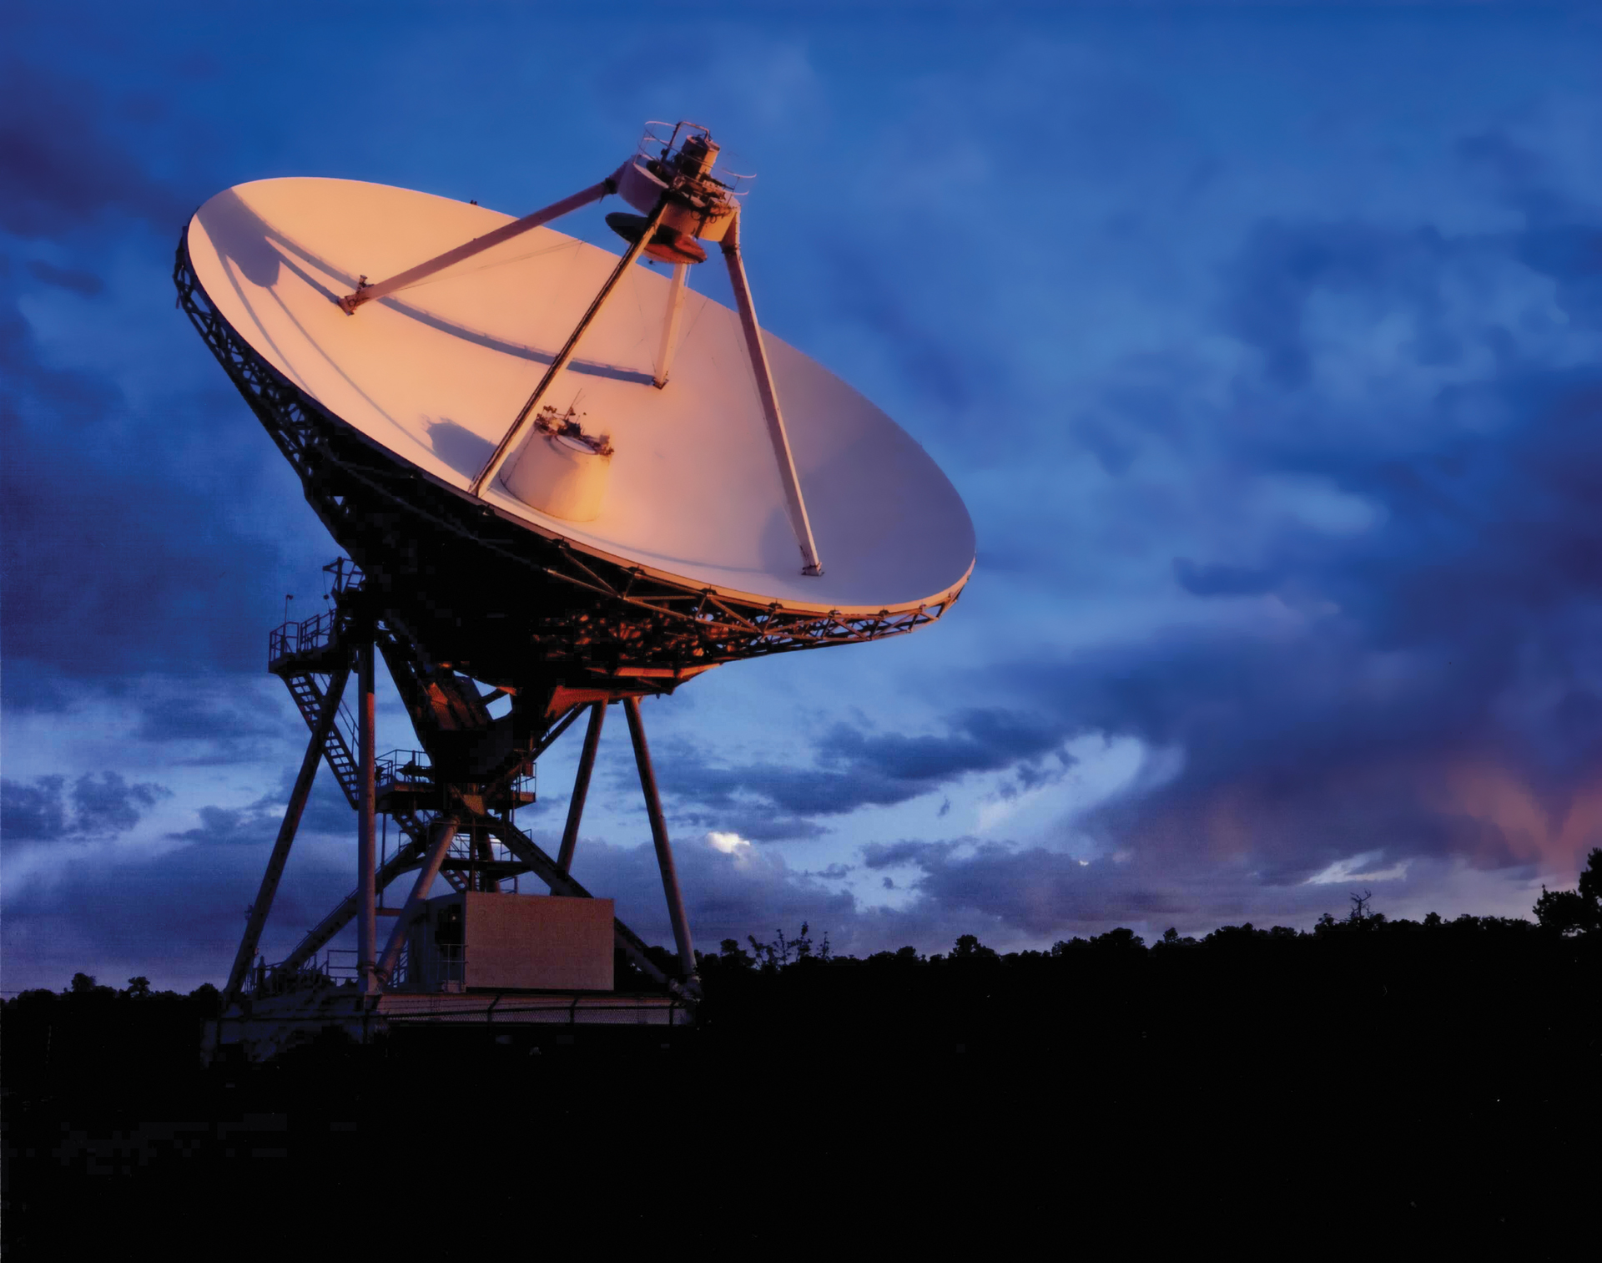
RIT
Scientific Services : Radio Astronomy (RAS)
Radio Astronomy uses radio waves to study objects in space. It helps scientists learn about things in the universe that we can’t see with regular telescopes.
RAS uses radio telescopes to captures faint radio signals.
Stars, planets, and galaxies far away and other mysterious objects.​
The leftover energy from the Big Bang.​
https://public.nrao.edu/radio-astronomy/the-technology-of-radio-astronomy/
https://en.wikipedia.org/wiki/Radio_astronomy

Slide 31
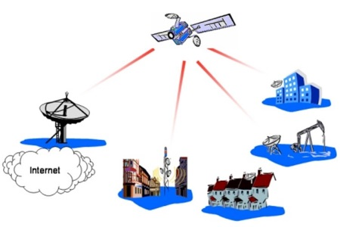
RIT
Non-scientific Services: Fixed Satellite (FSS)
FSS involves communications between ground stations and satellites in fixed locations. This service includes the ISS.
Television broadcasts, ​
International internet connectivity, ​
Data transmission over long distances.​
Notes:
FSS relies on stationary ground equipment at predefined locations for both transmitting and receiving satellite signals. This category encompasses a wide range of services, from international internet connectivity
This service includes satellite-to-satellite links, which may also be operated in the ISS.
It is commonly used for television broadcasts,
international internet connectivity,
and data transmission over long distances.

Slide 32
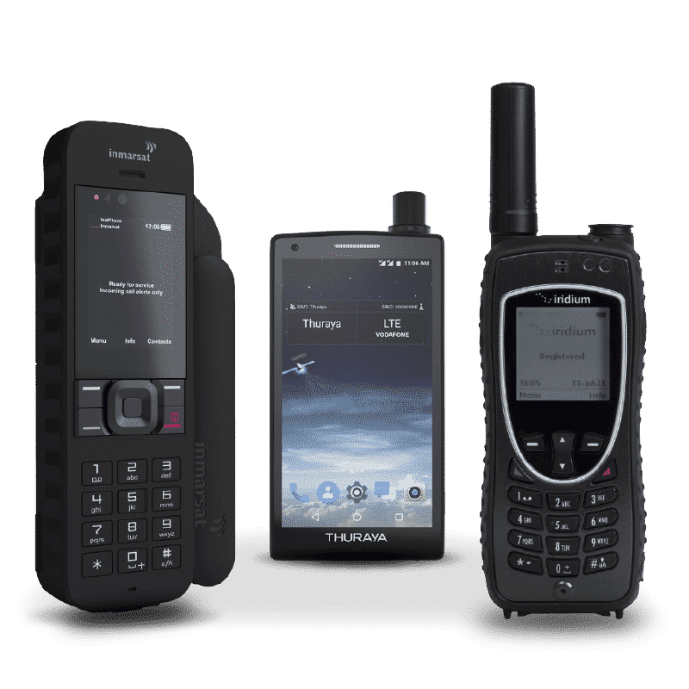
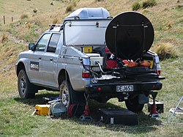
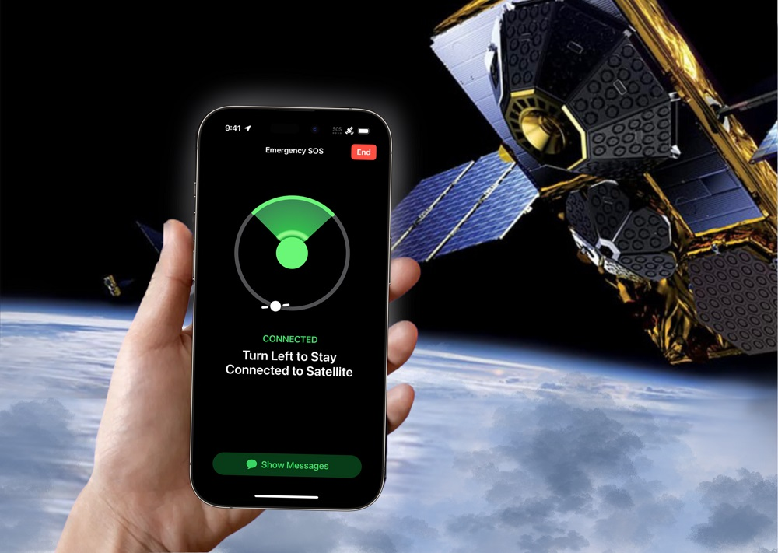
RIT
Non-scientific Services: Mobile Satellite (MSS)
Provide two-way voice and data communications to global users who are in remote locations. It ensures communication connectivity while on the move.
Satellite phones, Emergency satellite phones,
Notes:
provide two-way voice and data communications to global users who are on the go or in remote locations; terminals range in size from handheld to laptop-size units. Terminals can also be mounted in a vehicle, with communications maintained while the vehicle is moving.
Mobile Satellite Service (MSS) provides communication services to mobile users anywhere on Earth by connecting them to satellites in space. It is commonly used in areas where regular cell towers or terrestrial networks are unavailable, like remote regions, oceans, or disaster zones.
Image 1:
Land mobile earth station of the land mobile-satellite service, to send news via satellite link used by TVNZ reporters

Slide 33
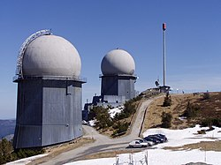
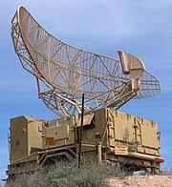
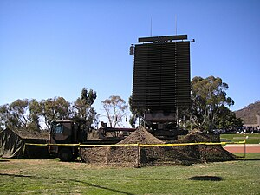
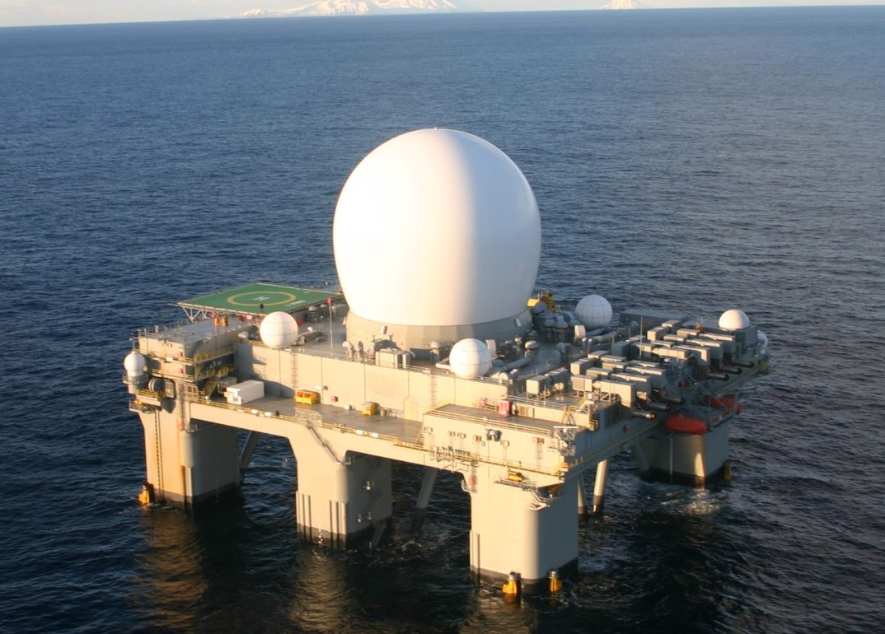
RIT
Non-scientific Services : Radiolocation (RLS)
Radiolocation Service (RLS) uses radio waves to determine the position, speed, and movement of objects. It is widely applied in systems like radar, which detect and track objects for navigation, safety, and surveillance.
Tracking airplanes, ships, or vehicles.​
Notes:
These waves are very faint and come from natural sources like stars or even gas clouds in space.
Radiolocation, also known as radiolocating or radiopositioning, is the process of finding the location of something through the use of radio waves.

Slide 34
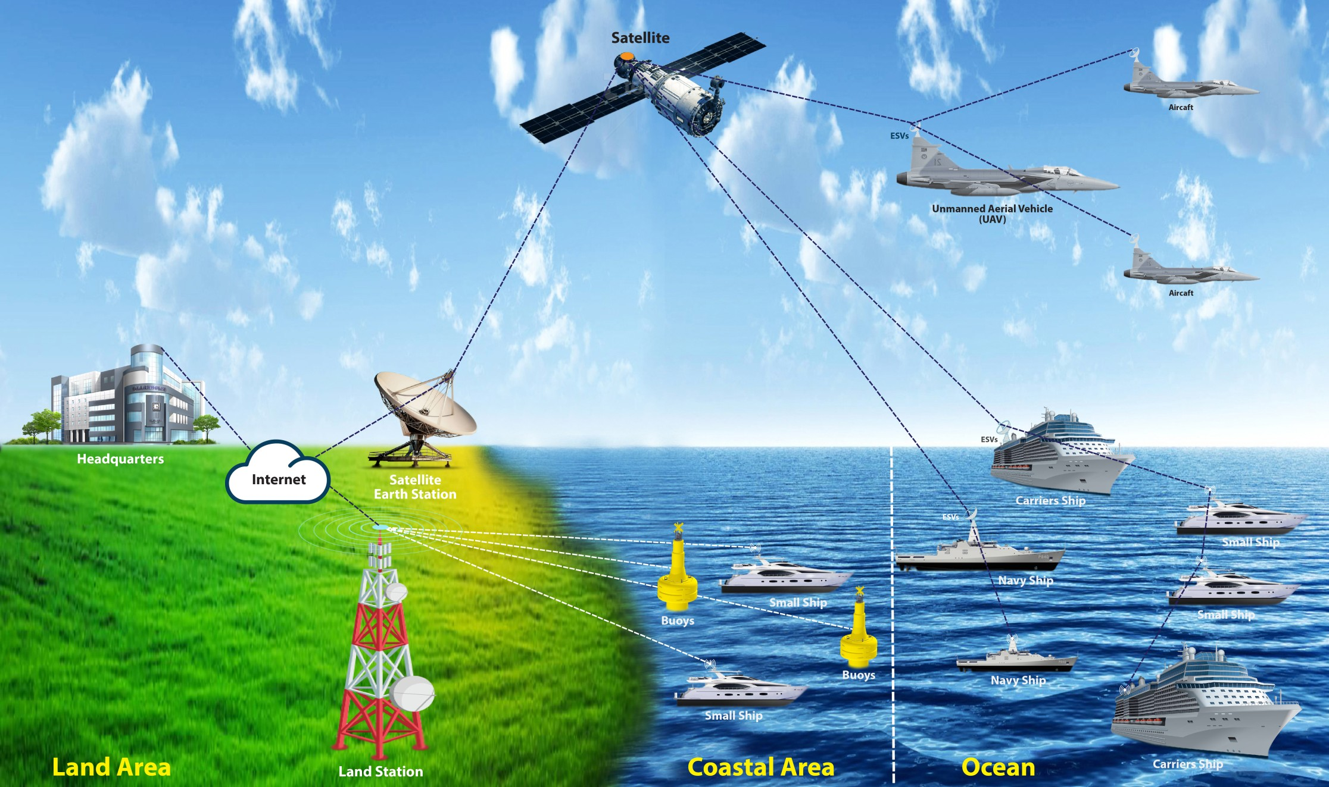
RIT
Non-scientific Services : Maritime Mobile Satellite (MMSS)
Provides communication between ships at sea and satellites in space, ensuring reliable connectivity for navigation, safety, and operational needs even in remote oceanic areas where traditional networks do not reach.
Communication between ships and ​
their headquarters​
Internet and Crew Welfare​
navigation data and weather updates.​
Notes:
Maritime Mobile Satellite Service (MMSS)
The Maritime Mobile Satellite Service (MMSS) provides communication between ships at sea and satellites in space, ensuring reliable connectivity for navigation, safety, and operational needs even in remote oceanic areas where traditional networks do not reach.
This service provides satellite communication for ships and other maritime vessels. It is crucial for navigation, safety, and communication at sea.
How It Works:
Satellite Communication:
Ships use onboard satellite communication systems to send and receive signals.
These signals are relayed via satellites to ground stations and vice versa.
Global Coverage:
MMSS uses satellites in geostationary or low Earth orbit to provide near-global coverage, ensuring connectivity even in the middle of the ocean.
Applications of MMSS:
Safety and Emergency Communication:
Ships can send distress signals and communicate with rescue services during emergencies (e.g., SOS via GMDSS - Global Maritime Distress and Safety System).
Operational Connectivity:
Enables communication between ships and their headquarters for logistical and operational updates.
Navigation Support:
Provides real-time navigation data and weather updates.
Internet and Crew Welfare:
Offers internet and communication services for the crew to stay connected with their families and the outside world.
Examples of MMSS Systems:
Inmarsat:
A key player providing maritime satellite communication for safety and operational needs.
Iridium:
Known for global satellite coverage, including polar regions.
Thuraya:
Offers regional satellite services with high reliability.
Relevance to FR3:
The upper midband frequencies (FR3) enable faster and more reliable communication for MMSS applications.
This is particularly important for high-data-rate services like internet access, video streaming, and advanced navigation systems.
Simple Example:
Imagine a ship in the middle of the ocean where there are no cell towers. MMSS acts like a "space-based phone line," connecting the ship to a satellite, which then connects it to the rest of the world. Whether it’s checking weather updates, calling for help, or just sending an email, MMSS makes it possible.
Would you like help including visuals like satellite-to-ship diagrams or examples of real-world MMSS applications?

Slide 35
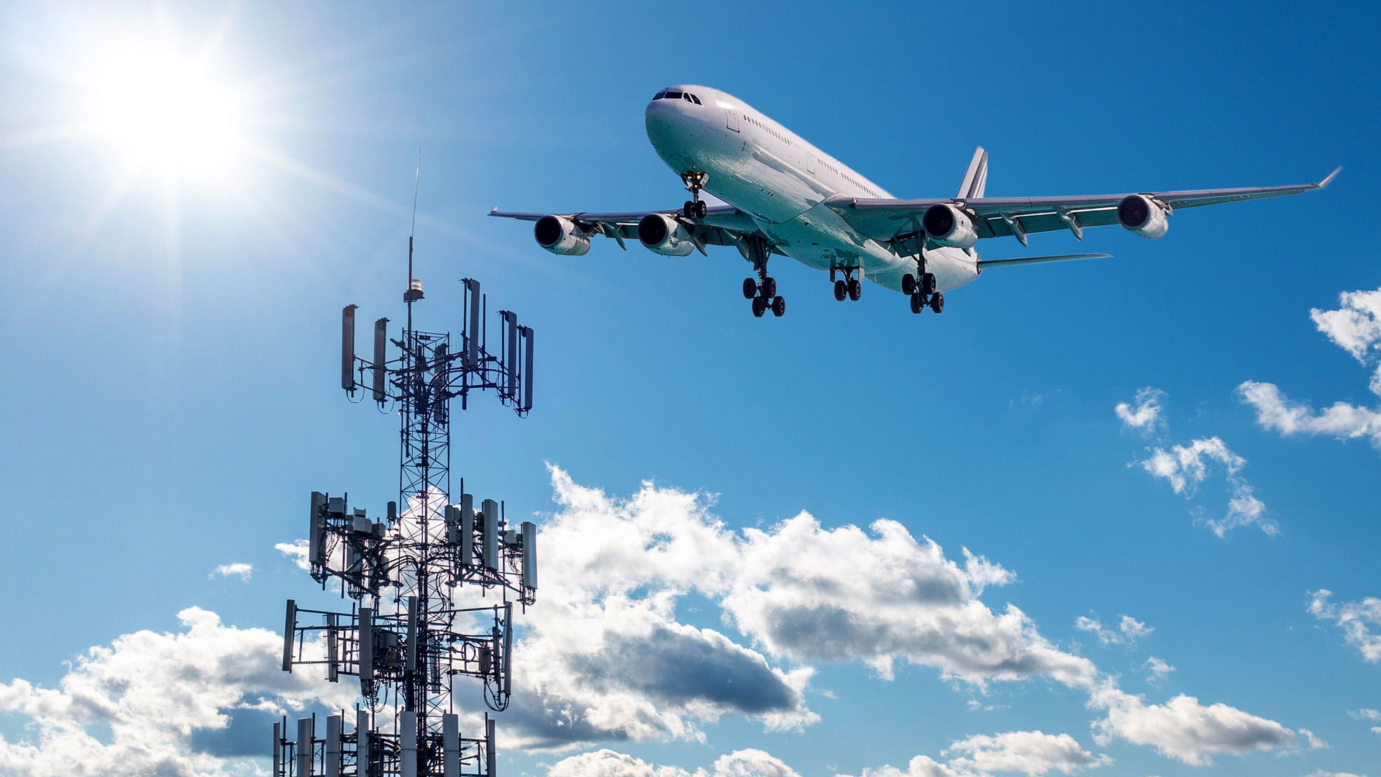
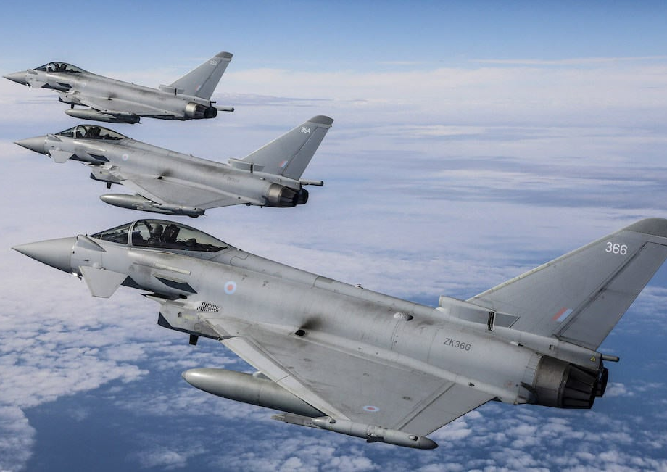
RIT
Non-scientific Services: Aeronautical Radionavigation (AR)
Helps pilots and air traffic controllers guide airplanes safely during flight, takeoff, and landing.
Navigation Systems​
Landing Assistance​
Collision Avoidance​
Search and Rescue​

Slide 36
RIT
Fundamental sharing framework
New entrant capabilities
Incumbent capabilities and limitations
Frequency and time coordination capabilities
Interference reporting mechanisms
Success of spectrum sharing depends upon a few basic components:
They have to work in harmony with each other for the overall benefit

